Slide 1





Presentation on Comparative study of Algorithms use in Sentiment analysis
Presented By:
Arun Prajapati (740305)
Neetu Phaiju (740324)
Rabin Phaiju (740329)
Rodip Duwal (740334)
2022 / 3 / 4

Slide 2
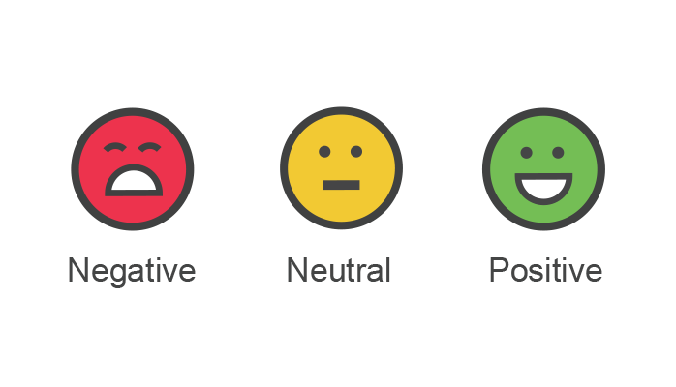
Outline
Introduction
Objective
Motivation
Scope and Application
Literature Review
Classification Algorithms
Result
Dataset Evaluation
Sentiment Analyzer
Rest API

Slide 3
Introduction
Opinion Mining
Natural Language Processing Technique
Identify that the opinions is positive or negative
Methods:
  Lexicon Based
  Machine Learning Based
Classification Levels:
  Document Level
  Sentence Level
  Aspect Level

Slide 4



Objective
To evaluate persons opinion and performance parameter of different algorithms.

Slide 5


Motivation
To know user’s opinion
Provide general search for “opinions”

Slide 6







Scope and Application
Data mining, web mining and social media analytics
Categorize urgency of mentions according to the relevancy scoring (i.e., which platform, type of user is vital to the brand)
Market Research

Slide 7
Literature review
Most sentiment analysis tools today uses lexicon-based approach but supervised machine learning methods, such as SVM and naive Bayes, have higher precision.
In 2010, Pak and Paroubek proposed model to classify the tweets as objective, positive and negative.
In 2010, Barbosa et al. designed two-phase automatic sentiment analysis method for classifying tweets.
Agarwal et al. (2011) developed a 3-way model for classifying sentiment into positive, negative and neutral classes.

Slide 8
Literature review (Cont..)
In 2011, M. Taboada, J. Brooke, M. Toﬁloski, K. Voll and M. Stede, Lexicon-based methods for sentiment analysis.
In 2011, Han-Xiao Shi, Xiao-Jun Li created a sentiment analysis model for hotel reviews based on supervised learning approach using unigram feature with two types of information (frequency and TF-IDF) .
In 2017, D. Vilares, C. G´omez-Rodrıguez and M.A. Alonso, Universal, unsupervised (rule-based), uncovered sentiment analysis, Knowledge-Based Systems.
In 2019, Saad and Yang aimed for giving a complete tweet sentiment analysis on the basis of ordinal regression with machine learning algorithms.

Slide 9
Comparative Study using:
Naive Bayes
Logistic Regression
Random Forest
1
3
5
2
4
6
Decision Tree
KNN
SVC

Slide 10
Algorithm
Naive Bayes
  Collection of classification algorithms based on Bayes’ Theorem.
  Used for making predictions in real time. Also known as multi class prediction feature.
Decision Tree
  Applied on classification or regression based problems.
  Used to arrive at conclusions based on the data available from decisions made in the past.

Slide 11
Algorithm (Cont..)
Logistic Regression
  Classification algorithm used to predict the probability of a target variable.
  Used across many scientific fields. In NLP, used to determine sentiment of movie reviews while in medicine, used to determine the probability of a patient developing a particular disease.
KNN
  Algorithm used to solve both classification and regression problems.
  Used for recommendation system.

Slide 12
Algorithm (Cont..)
Random Forest
  Suitable for both classifications and regression task.
  Can handle missing values and maintain the accuracy of a large proportion of data.
SVC
  Applies a linear kernel function to perform classification and can also be extended to solve regression problem.
  Fit to the data and return a best fit hyperplane that divides or categorize the data.

Slide 13
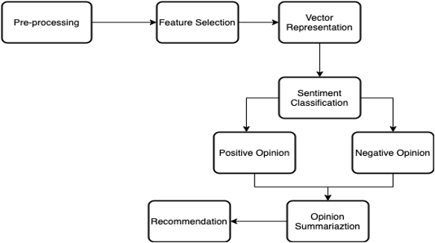
Methodology

Slide 14
Methodology (Cont..)
Preprocessing
  Tokenization
  Cleaning
  Stop word removal
  Stemming

Slide 15
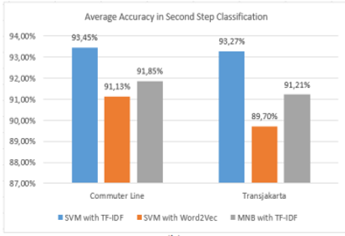
2. Feature Extraction
Tf-Idf
Word2Vec
Fig: Accuracy Comparision of Text Vectorizations

Slide 16
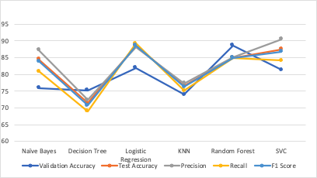
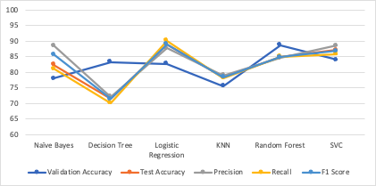
Result
Fig: Comparison of different performance measure of 6 different Algorithms for Movie dataset
Fig: Comparison of different performance measure of 6 different Algorithms for Conversation dataset

Slide 17
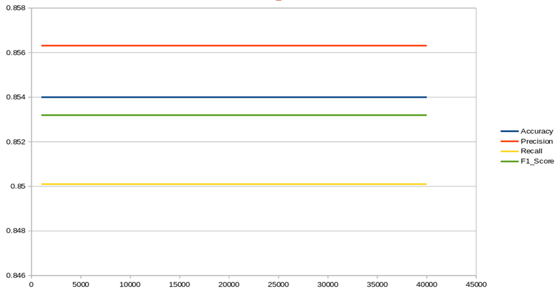
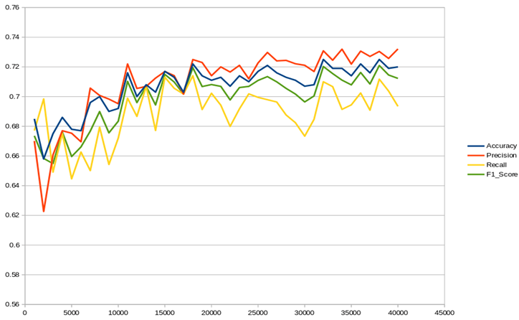
Dataset Evaluation
Fig: Comparison of different performance measure of Multinomial Naïve Bayes with respect to amount of data
Fig: Comparison of different performance measure of Decision Tree with respect to amount of data

Slide 18
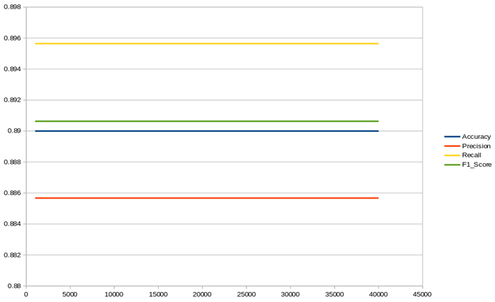
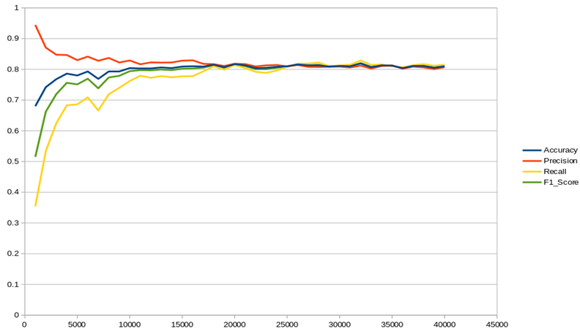
Dataset Evaluation (Cont..)
Fig: Comparison of different performance measure of Logistic Regression with respect to amount of data
Fig: Comparison of different performance measure of KNN with respect to amount of data

Slide 19
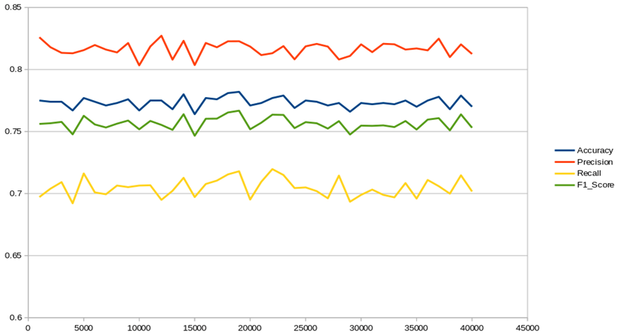
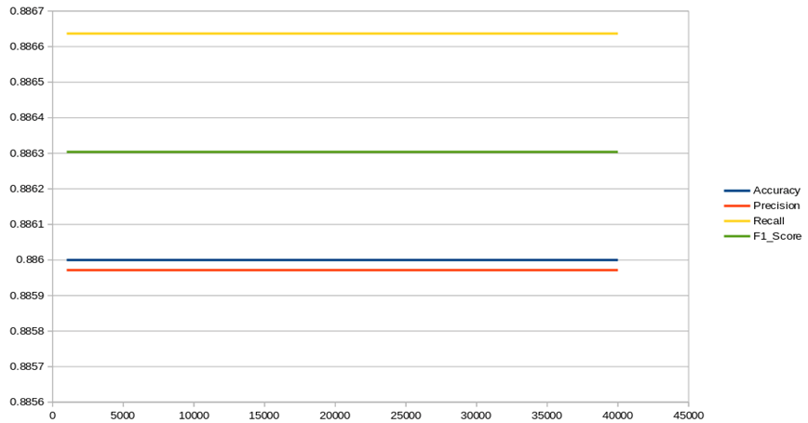
Dataset Evaluation (Cont..)
Fig: Comparison of different performance measure of Random Forest with respect to amount of data
Fig: Comparison of different performance measure of SVC with respect to amount of data

Slide 20
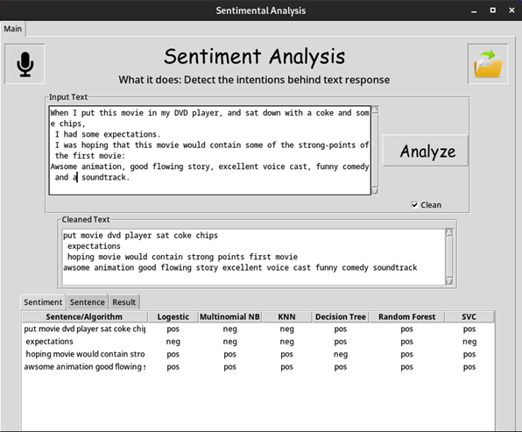
Sentiment Analyzer

Slide 21
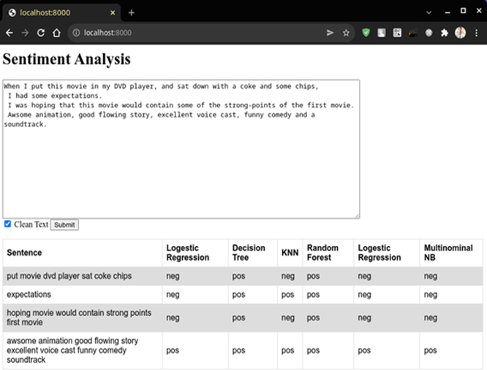
REST API
Notes:
Agi ko app desktop ko lagi matra bhana yo chai ja pani use garnu milxa bhana

Slide 22
Thanks!
Any questions?

